Slide 1
Chapter 12
Parallel Processing and Performance

Slide 2
Chapter Outline
Multithreading
Vector (SIMD) processing
Shared-memory multiprocessors
Cache coherence for shared data
Message passing multicomputers
Parallel programming
Mathematical modeling of performance

Slide 3
Hardware Multithreading
A process is a program and its current state
(e.g., a Web browser or a word processor)
Each process has a corresponding thread, which is an independent path of execution
Encompasses state in PC and other registers
Operating system (OS) enables multitasking by time slicing and context switching of threads
For efficient handling of multiple threads, processors can use hardware multithreading

Slide 4
Hardware Multithreading
Hardware includes multiple sets of registers, including multiple program counters
Each set of registers is for a different thread
No time is wasted saving/restoring registers
Context switch simply involves changing a hardware pointer to active set of registers
Coarse-grained multithreading: switch on long-latency events, such as cache misses
Fine-grained or interleaved: switch every cycle

Slide 5
Vector (SIMD) Processing
A vector is an array of consecutive elements
Loops process arrays one element at a time
Implementing a processor with multiple ALUs enables multiple operations simultaneously
Requires that programs have data parallelism, which means operations are independent
Use single-instruction multiple-data (SIMD) or vector instructions and data in vector registers

Slide 6
Vectorization
Vector length L for elements per register and number of parallel operations per instruction
Use this parameter to vectorize loop code
Involves using vector (SIMD) instructions to reduce the number of instructions executed
A vectorizing compiler can perform analysis to detect data parallelism for transformation
Each pass of vectorized loop does L operations to ideally reduce instruction count by factor L

Slide 7
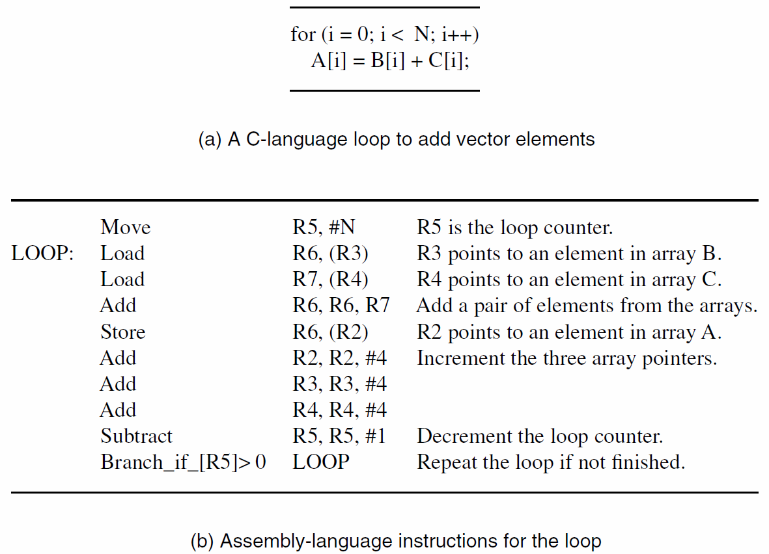

Slide 8
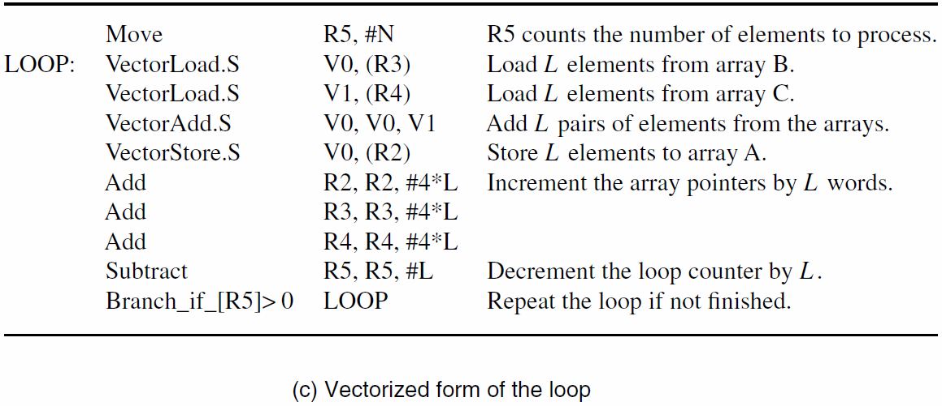

Slide 9
Graphics Processing Units (GPUs)
Demand for high-resolution, 3-D graphics has driven development of powerful GPU chips
Graphics applications have data parallelism in floating-point calculations and other tasks
Large GPUs have hundreds of simple cores
General vector processing possible with cores executing the same program on different data
Programming support: CUDA C and OpenCL

Slide 10
Shared-Memory Multiprocessors
A multiprocessor consists of many processors simultaneously executing independent tasks
Shared-memory multiprocessor: all processors access same memory with same addresses
For large memory, distribute in many modules to service multiple requests simultaneously
Use an interconnection network to connect multiple processors with multiple memories

Slide 11
Shared-Memory Multiprocessors
Network introduces latency to access memory
Uniform Memory Access (UMA) system gives same latency for any processor/memory pair
Even if latency is common, it may still be large
For better performance, put memory module with each processor for a collection of nodes
Non-Uniform Memory Access (NUMA) system has lower latency for local (vs. remote) access

Slide 12
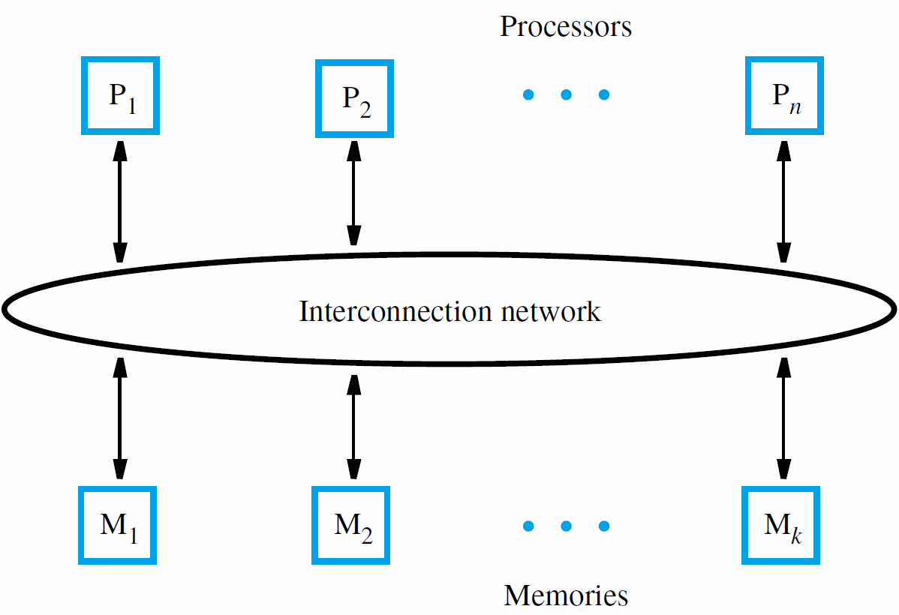
Uniform Memory Access (UMA) multiprocessor

Slide 13
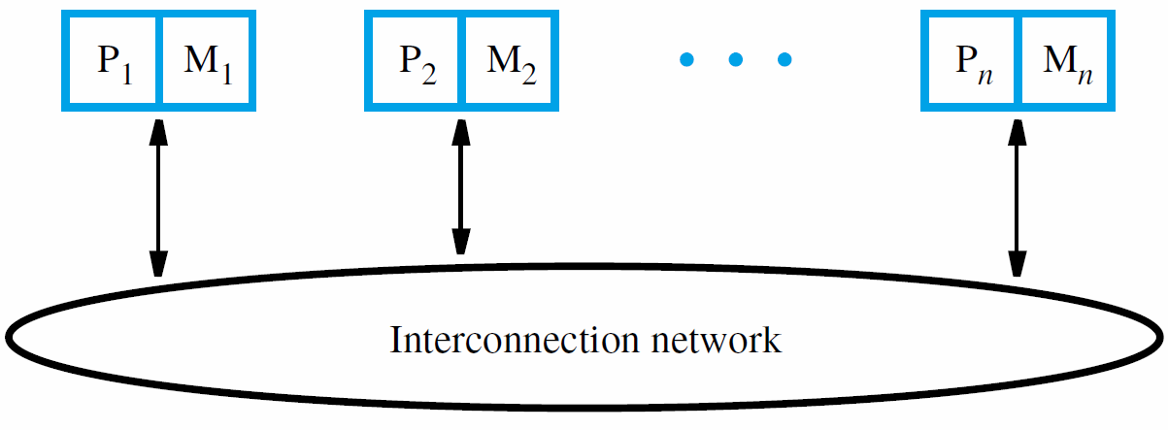
Non-Uniform Memory Access (NUMA) multiprocessor

Slide 14
Interconnection Networks
For transferring information between nodes or for broadcasting information to all nodes
Suitability of any particular network judged by cost, bandwidth, and effective throughput
Bandwidth is capacity in bits per second
Effective throughput is actual (lower) rate due to need for transferring control information
Transfers usually done with fixed-size packets

Slide 15
Bus and Ring
A bus is a set of lines providing a shared path
Requires arbitration for one access at a time
Simple bus is held until response is ready, but split-transaction bus can overlap requests
A ring provides point-to-point connections
Bi-directional ring halves average latency
Hierarchy of rings reduces latency for transfers within a lower-level ring or between rings

Slide 16
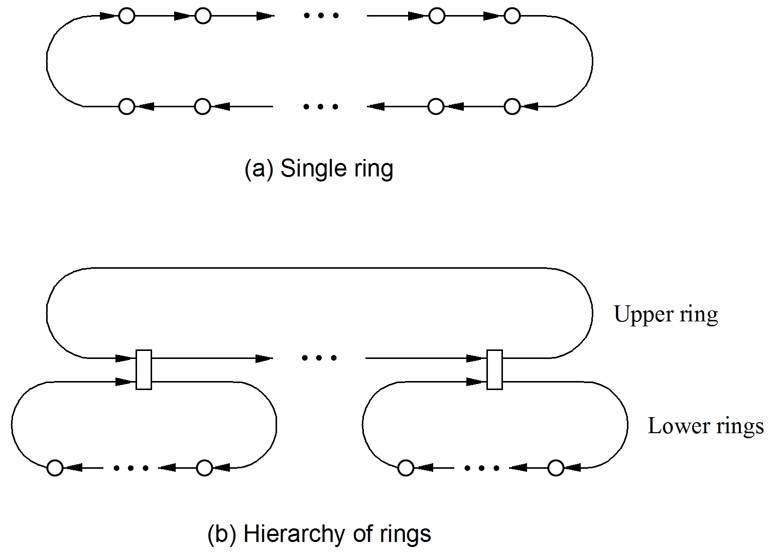

Slide 17
Crossbar and Mesh
A crossbar provides a direct link between
any pair of units connected to the network
Can implement with collection of switches for simultaneous transfers to different destinations
A mesh connects nodes horizontally/vertically except at boundaries and corners
Reduce latency between opposite boundaries with wraparound connections, giving a torus

Slide 18
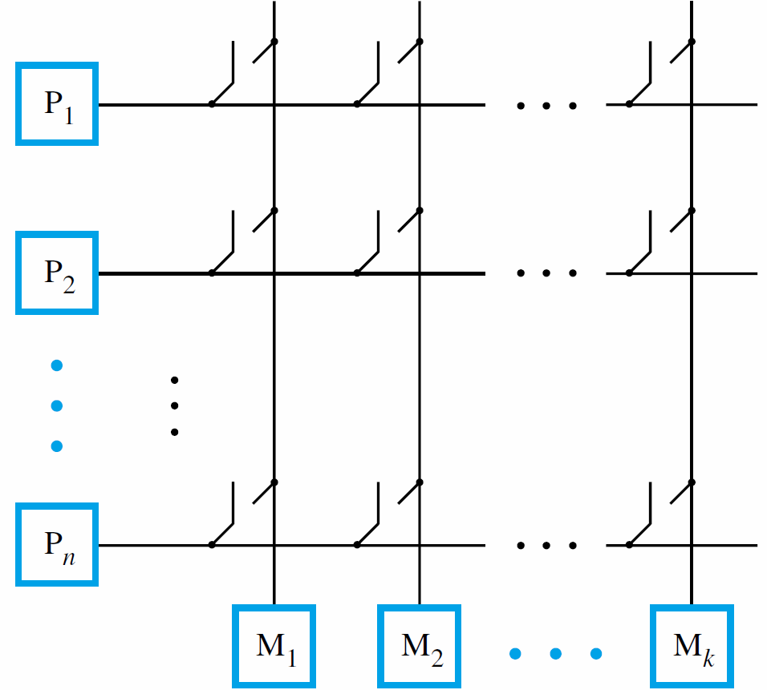

Slide 19
Cache Coherence
Multiprocessors with shared memory allow processors to use same address for a location
If each processor has a cache, there may be multiple copies of the same shared data
When one processor then writes to its cache, all other caches will have old, incorrect value
Must either update or invalidate other copies
Cache coherence – enforcing a consistent view of shared data in multiple caches

Slide 20
Write-Through Protocol
Can allow each write to be performed in cache and also in corresponding memory module
This approach is the write-through protocol
What about the other caches?
Update version of protocol broadcasts data
for other caches to accept (if block in cache)
Invalidation version broadcasts a notification for other caches to mark any copies as invalid

Slide 21
Write-Back Protocol
Can perform write only in cache, not memory
Block ownership concept – if memory copy is valid, block belongs to memory, even if shared
Processor must obtain ownership before write by first broadcasting an invalidation request
Later read from another processor forwarded to processor that has ownership & new value
Copies of block sent to requester & memory
Memory reacquires ownership, block is shared

Slide 22
Write-Back Protocol
When another processor wishes to write a modified block, current owner sends data
Provider of modified block invalidates copy, thereby transferring ownership as well as data
Memory is not updated; it is not the owner
Consider multiple writes by same processor before ownership of block changes
Write-back creates less traffic in this case than write-through; only initial request is broadcast

Slide 23
Snoopy Caches
Broadcasting of requests for cache coherence is most easily accomplished on a single bus
Suitable for a modest number of processors
Each request seen at same time by all units
The controller for each unit snoops (observes) transactions and reacts to enforce coherence
This is a snoopy-cache coherence scheme
Use duplicate tags to support cache snooping without interfering with processor accesses

Slide 24
Snoopy Caches
Processor wishing to write to shared block must first send invalidation request to bus
All controllers snoop duplicate tags, accessing main tags only if copy of block is in that cache
Another processor later sends read request
Current owner identified after snooping, and it asserts signal to prevent memory response
Current owner then broadcasts block data on bus for requester and memory to accept

Slide 25
Snoopy Caches
Now consider two processors sharing a block
Both simultaneously attempt write to block
Memory is the current owner, so processors must compete for transfer of ownership
Bus arbitration selects winning processor, which then broadcasts invalidation request
Other processor loses its copy of block, but still needs to obtain block with ownership
So it broadcasts read-exclusive request for this

Slide 26
Directory-Based Cache Coherence
Large-scale shared-memory multiprocessors use ring or mesh interconnection networks
Full broadcast of all requests is not efficient
Directory-based schemes are more scalable
For each block in a memory module, identify which nodes have copies, and if it is modified
Request sent to module containing the block for limited broadcast, or to forward to owner

Slide 27
Message-Passing Multicomputers
Message-passing multicomputers have nodes with memory accessed only by local processor
Each node is effectively a complete computer
Sharing of data requires exchanging messages
Program in source node makes send request
Destination program makes receive request for message to be copied into node’s memory
For efficiency, nodes use communication units to format/transmit/accept/copy messages

Slide 28
Parallel Programming
Use multiprocessors to exploit parallelism
in loops and in other higher-level tasks
Hardware alone cannot achieve this goal
Compiler could detect and exploit parallelism, but not feasible for all types of applications
Hence, the need for parallel programming
The programmer has the responsibility to partition overall computation into tasks and to specify how they are executed in parallel

Slide 29
Thread Creation/Synchronization
Two issues for parallel programming:
(a) enabling execution on multiple processors
(b) determining task completion
Thread creation uses a create_thread request to OS with a subroutine pointer as parameter
New thread executes subroutine, calls others using its own stack for local variables
Global variables shared with other threads

Slide 30
Thread Creation/Synchronization
Thread synchronization uses OS routines to coordinate execution of multiple threads
Determine when threads complete tasks to ensure correct computation of final results
One method is to use a barrier routine
Forces threads to wait until all of them have reached the point where this routine is called
Threads at the barrier enter a busy-wait loop until last one arrives to signal all to continue

Slide 31
Example Parallel Program
Consider a program in the C language that computes the dot product of two vectors
Details omitted for initializing data in vectors
Each of the N passes in the loop depends on partial sum computed in preceding pass
But independent tasks can be created by exploiting associative property of addition
Parallel program creates threads, assigns tasks by thread ID, and uses barrier synchronization

Slide 32
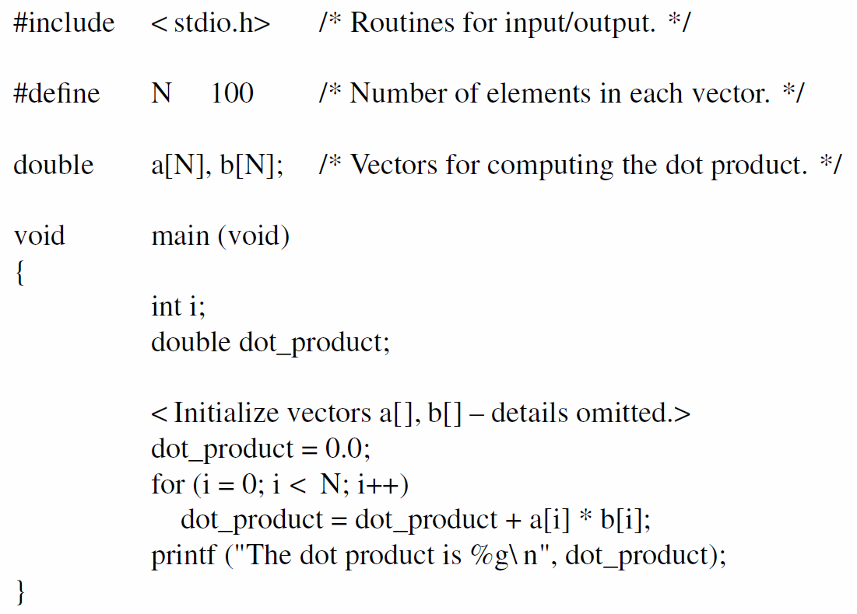

Slide 33
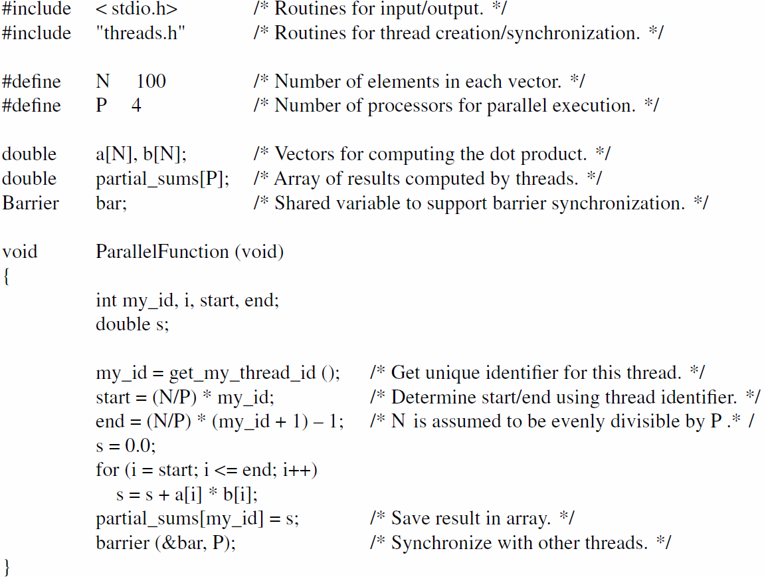

Slide 34
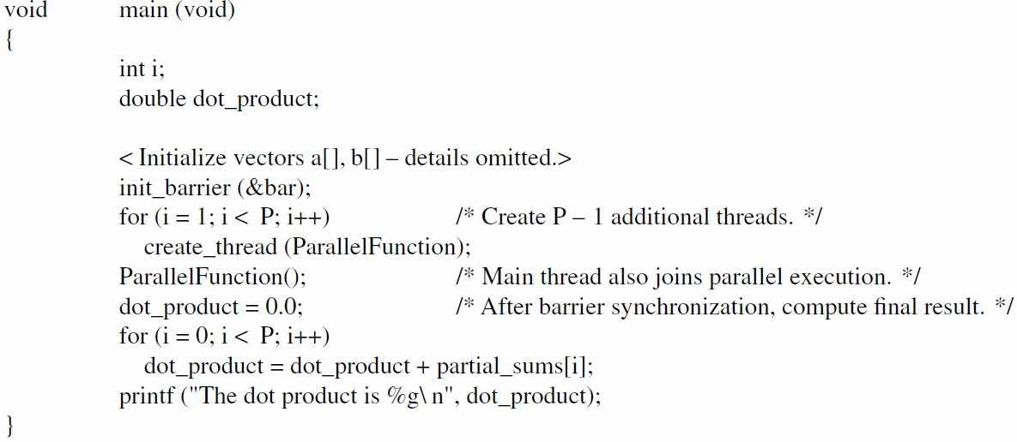

Slide 35
Performance Modeling
Useful to predict, even if done approximately, potential speedup from some enhancement
Assume T_{orig} is execution time for program
Assume f_{enh} , f_{unenh} are enhanced/unenhanced fractions of original time ( f_{enh} + f_{unenh} = 1)
Assume that factor of improvement is p
New time is T_{new} = T_{orig} ( f_{unenh} + f_{enh} / p)
Amdahl’s Law for speedup: 1 / ( f_{unenh} + f_{enh} / p)

Slide 36
Concluding Remarks
Pipelining and caches previously presented as important performance-enhancing techniques
This chapter presented additional techniques
Multithreading involves additional hardware for efficient context switching
Vector (SIMD) instructions use multiple ALUs to perform the same operation in parallel
Parallel programming on multiprocessors used for simultaneous execution of larger tasks

